Slide 1
Transactional Process Improvement

Slide 2

Other Modules In This Series:
5S
Standard Work
Total Productive Maintenance (TPM)
Administrative Lean
Cell Design/ Production Preparation Process (3P)
Kaizen
Kanban
Problem Solving
Poka Yoke Quality Systems
Transaction Process Improvement (TPI)
Cause & Effect Diagram with the Additions of Cards (CEDAC)
Single Minute Exchange of Dies (SMED)
Value Stream Mapping (VSMi®)
Visual Management
Managing Daily Process Excellence
For More Information Please Contact:
Mark DeLuzio, President and CEO
+1.860.234.0915
mark.deluzio@leanhorizons.com
Strategically Creating Value Through the Elimination of Waste

Slide 3
This document contains confidential
and proprietary information owned
by Lean Horizons Consulting, LLC.
Any disclosure, use, copying or
distribution of this information without the express written consent of Lean Horizons Consulting is strictly prohibited.

Slide 4
Ground Rules for Event
Safety first (use personal protective equipment)
Active participation by all
Start and end on time
All electronic gadgets (phones, pagers, etc) turned to “off” or “silent”
Computers to be used only when instructed
Keep an open mind to change
Don’t let “perfect” get in the way of “better”
Notes:
DO: Perform Group Introductions. Pick an ice-breaker or exercise to warm the team up to the event. (Icebreaker Example: Everyone uses their name tent and writes a “Personal License Plate” in which they have 2 minutes to creatively use a total of 7 letters or numbers to tell us something about themselves. Examples “LV2SAIL” OR “DADOV5”
DO: Review Event Ground Rules.
ASK: “Does anyone have any rules they would like to see added?”
ASK: “Does everyone agree to these?”

Slide 5
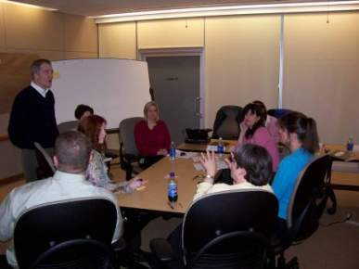
Transactional Process Improvement (TPI)
A method of analyzing existing processes and discovering, defining, and implementing revised processes in a service enterprise or in the office side of a production enterprise
The boundaries of a TPI event are defined by two process steps and surround a set of process steps usually targeted by a
Value Stream Plan
This can be very few steps or many depending on their nature

Slide 6
Goal of TPI
As a result of this training, you will be able to diagnose barriers to:
  Quality and/or
  Delivery and/or
  Cost
and design and implement the improved process.
Notes:
SAY: “We want to make sure we use our time this week to implement as many of the improvements that we identify as possible. It is important to mention that often times because the scope of a TPI event can cover a pretty large process, we will be scheduling activities beyond this week for implementation in order to reach our goal.”

Slide 7
TPI Linkage to Strategy
Make Improvements that Eliminate Waste:
**TPI**
Key
Business
Imperatives
Identify
and Map
Value Streams
Identify strategic
objectives and major
business improvement
opportunities
WASTE
Notes:
SAY: “It is better to have first have identified and quantified Strategic Imperatives. Next we map the Value Stream of the product family or service family pointed to by those Strategic Imperatives. A Plan for improving that Value Stream is then developed. It is that Plan that pointed us to working this week on this process, which is part of that Value Stream.”

Slide 8
Benefits of TPI
Benefits of TPI are most commonly reflected in:
  Improved quality of the inputs and outputs
  Shorter lead time
  Higher through-put rate
  Higher productivity
Sometimes all of these targets are pursued, but most
commonly only one

Slide 9
TPI Process
Repeat for each identified Value Stream
PROCESS STEP 1
PROCESS STEP 2
PROCESS STEP 3
PROCESS STEP 4
Strategic
Deployment AIPs
and Targets
Determined
Value Streams Identified and Mapped Administrative Waste Observed
Conduct
TPI Event
Implement
TPI Kaizen
Newspaper
and Future Plans
Repeat
Cycle
Complete
Description of
“As Is”
Process
Identify and
Define Barriers
within the
“As Is” Process
to the Goals
Identify the
Potential
Solutions
to the
Barriers
Complete
Description
of
“Should Be”
Process
Define and
Implement
Solutions
and/or
Schedule

Slide 10
TPI Session Agenda
Day | Key Learnings | Daily Deliverables
Day 1 | Introduction to TPI “As Is” Process Mapping | Complete “As Is” Process Walk Begin “As Is” Documentation
Day 2 | Continued “As Is” Process Mapping Identify and Define Barriers within the “As Is” Process to the goals and objectives | Complete “As Is” Process Documentation and Map and present to Leadership Complete Mark-up of “As Is” Process Map Present Barriers to Leadership
Day 3 | Identify the Potential Solutions to the Barriers Complete Describing the “Should Be” Process | Complete identification of potential solutions to the barriers Present potential Solutions to Leadership Draw “Should Be” Process Map and present to Leadership Begin to define and implement solutions and/or schedule Begin completion of “Should Be” Process Documentation Re-draw “Should Be” Process Map and present to Leadership
Day 4 | Define and Implement Solutions and/or Schedule | Complete defining and implementing solutions Complete Kaizen Newspaper and Future Plans Complete “Should Be” Process Documentation Prepare Report Out Presentation
Day 5 | Identify components of Report Out Presentation | Conduct Report Out
Notes:
SAY: “This is the typical 5 day agenda for what we will accomplish this week.”
NOTE: Deliverable dates can be adjusted as needed depending on the event.

Slide 11
Pre-Requisites for TPI
This TPI session assumes that all attendees have completed the Introduction to Lean
One participant per team must be proficient with Microsoft Excel and Process Mapping
One Participant per team must be knowledgeable enough of the process within the event boundaries to act as Tour Guide
TPI improvements often require system changes, and it is recommended that these resources (like IT) be either on the team or available to the team for the duration of the kaizen

Slide 12
Review of Pre-Event Preparation Document
Objective
Review Pre-Event Preparation Document with kaizen team.
Instructions
Time to Complete
Process Name(s)
Process Boundaries(s)
Team Leaders/Sub Team Leaders
Volume/Throughput (Units/Shift)
Goals/Objectives
Deliverables
10 minutes
Deliverable
Review complete

Slide 13
TPI Report-out Expectations
15-minute report-out presentation to leadership at end of week
All team members will take part in the report-out
Will likely be seeking leadership’s approval at the report-out to move forward on certain elements
It is possible that we will not have implemented, during the kaizen week, all of the necessary changes to achieve our goals and objectives; incomplete items need to be reflected in the report-out (method for doing this will be shown later)

Slide 14
Process Mapping Basics
Objectives:
  Define Process Mapping
  Differentiate Process Mapping from Value Stream Mapping
  Identify components of a process
  Identify the common symbology used in basic Process Mapping
  Identify methodology for constructing a Process Map
Notes:
DO: Review chapter objectives.
SAY: “In order to begin with TPI, we’ll need to cover some Process Mapping Basics.

Slide 15

Process Mapping
Graphic display of steps, events and operations that constitute a process
A picture or diagram of what is actually happening
A foundation for continuous improvement
A real-time planning and implementation tool
In TPI, we will be using a simplified version of Process Mapping
Notes:
SAY: “In TPI we will use a simplified format of Process Mapping. In traditional Process Mapping, there are many symbols that identify delays, queues, transportation, etc. For TPI purposes, we will only be using the 5 process mapping symbols on this slide.”

Slide 16
Value Stream Map and Process Map Distinction
Detailed graphical depiction of a manufacturing or business process
Used to identify specific improvements
Incorporates decision loops within the process
I
I
High-level snapshot of end-to-end
business
Used to identify where opportunities for improvement exist
Does not incorporate decision loops
Notes:
SAY: “A Value Stream Map is the “30,000-foot” view of the process. A Process Map is a tool that would take just one process box from a Value Stream Map, and explode that process into it’s detailed steps.”

Slide 17
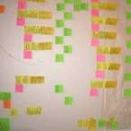
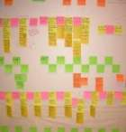
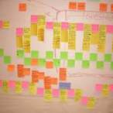
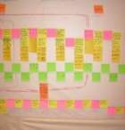
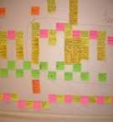
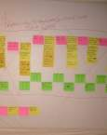
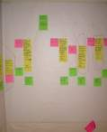
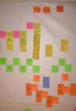

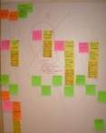


Example: From VSM to Process Map
ACME AUTO Current State Value Stream Map After Automobile Sales Service Process
Auto Service Reception

Slide 18
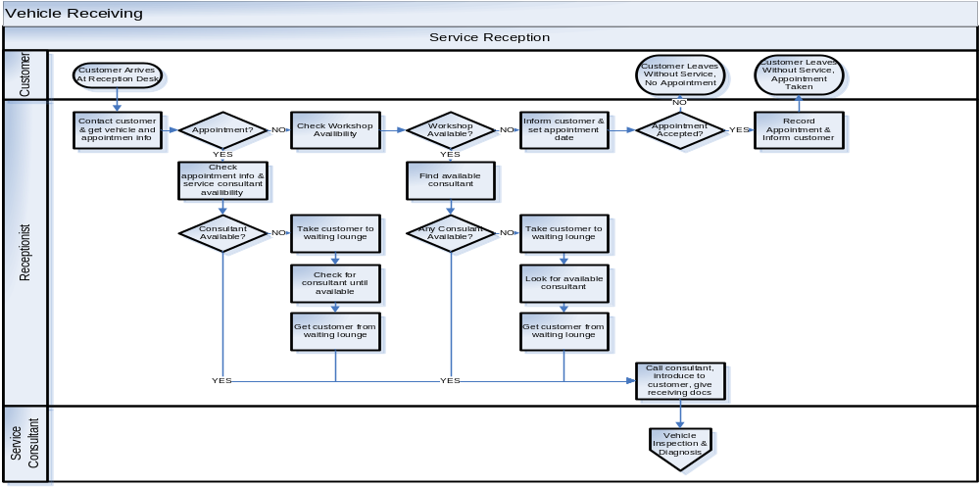
Process Map of Auto Service Reception Process

Slide 19
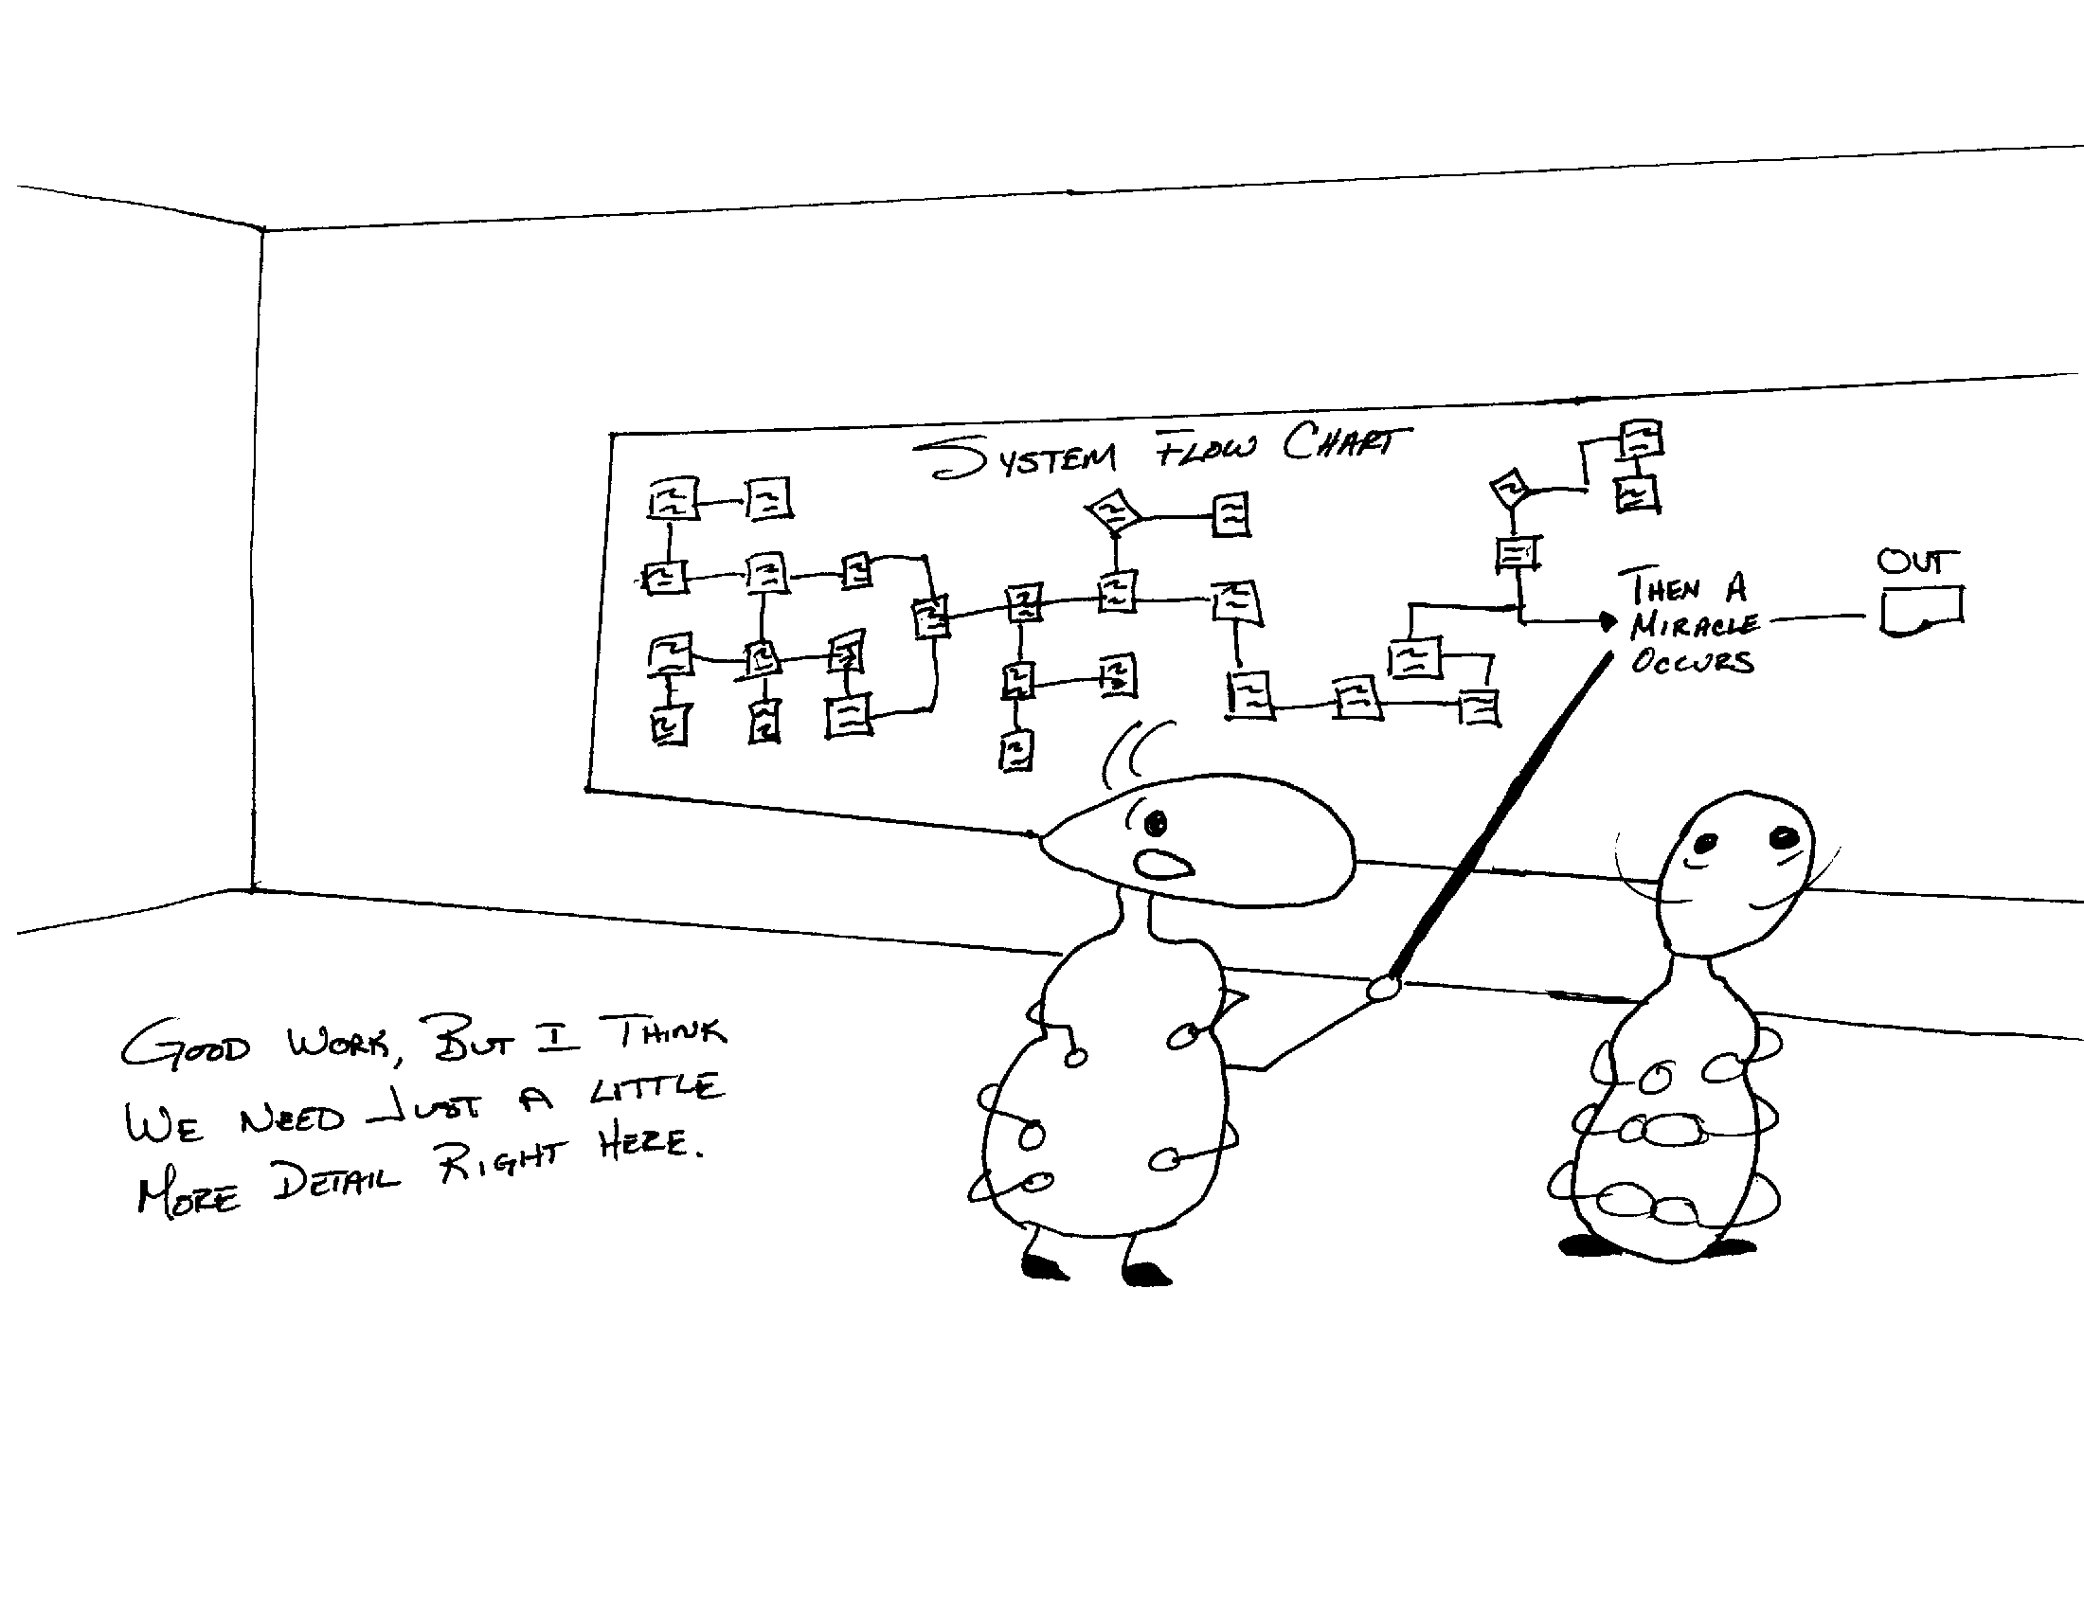

Slide 20
Any Process has at Least Three Versions
What you THINK it is:
What it ACTUALLY is:
What it SHOULD be:

Slide 21
Process Mapping
Process Maps start at the beginning of the process
Start with the input that initiates the process
Ask, “What happens next?”
Record each step in boxes flowing from left to right or top to bottom. Put in arrows to show the flow of the process
When the flow can go in two directions, draw a diamond around a yes/no question and put in two arrows to show the two directions
Make sure each branch of the flow chart is complete
Always sign and date the flow chart for future reference
Notes:
Note that with Process Mapping we map the process from beginning to end unlike VSM where we map the process from end to beginning.

Slide 22




Process Mapping Symbols
Symbol | Name | Definition
 | Process Box | An operation or step.
 | Decision | A question or branch in the process.
 | Terminator | A start or stop point in the process.
 | On-page Connector | A jump point from one point to another on the page.
 | Off-page Connector | A jump point from one point to another on separate pages
In TPI, we will use a simplified version of Process Mapping
Notes:
SAY: “In TPI we will use a simplified format of Process Mapping. In traditional Process Mapping, there are many symbols that identify delays, queues, transportation, etc. For TPI purposes, we will only be using the 5 process mapping symbols on this slide.”

Slide 23

Process Mapping
Process takes place using Post-it style notes on the wall
Recommended color coding:
  Yellow – Process Step
  Blue - Decision
  Pink - Notes

Slide 24
Process Map Example
Me
Hungry
Select from
Menu
Comm. To
Waiter
Repeat
No
Record
Selection
Is It Correct?
Place Order
Waiter
2
1
Yes
Kitchen

Slide 25
Process Map Example
What is the “right” amount of detail?
Me
Consume
Full
VA
Comm to
Me
Deliver
Waiter
1
2
No
Queue for
Preparation
Do We Have Ingredients?
Prepare
Selection
Queue for
Waiter
Kitchen
Q
Yes
Q

Slide 26
When the Use of “Swim Lanes” is Appropriate
A “swim lane” is a visual way to separate the process steps by who is conducting that process step
Swim lanes visually distinguish handoffs throughout the flow as well as easily identify who is doing what part of the process
Use swim lanes when:
  the process moves across several functional or product grouping lines
  the movement across such lines is complex, frequent, and cycles back
  separating by lane makes the process clearer, not more confusing

Slide 27
Process Map Example Using Swim Lanes
Marketing
Concept
1
2
Correct?
No
Marcom
Manager
Platform is
Created
Yes
New Job
Opened
VA
Insp
Lit code needed?
Log new
Job
Update log
Update log
and sign
Traffic
Insp
3
Graphics
Draft Copy
Created
Create imagery
Assemble 1st
Proof
Place Sticker/
Log into
tracking sys
VA
Insp
Production
Notify External
Vendors/ Quote

Slide 28
Process Map Exercise
Objective
Draw a basic Process Map
Instructions
Time to Complete
Use the basic Process Mapping symbols introduced in this chapter to map the process of starting your automobile.
Use the next page to draw the map of your process.
10 minutes
Deliverable
Share process maps

Slide 29
Process Map Exercise
Process Map Exercise
Open Car Door
Engine Starts
Notes:
DO: Ask for volunteers to share their processes.
ASK: “Which one is correct?” (answer: all of them)
ASK: “Why is everyone’s different?” (answer we all may do it differently – but more importantly we were going from memory – what we THINK we do – when we map processes it is important to walk the process and observe it for ourselves.”

Slide 30
Complete Describing the “As Is” Process
Complete “As Is” Process
Identify &
Define Barriers
Identify
Potential
Solutions
Complete
“Should Be” Process
Define and
Implement Solution
Objectives:
Confirm the boundaries of the process
Define elements of a Process Walk
Identify deliverables of Process Walk
Define components of Process Walk Form
Perform Process Walks
Complete Process Data Summary Sheet and Spaghetti Diagram for As Is Process
Draw a consensus “As Is” Process Map
Notes:
DO: Review section objectives on slide.

Slide 31
As Is/Should Be vs. Current State/Future State
Complete “As Is” Process
Note that in TPI we choose to use different names for our before and after than the ones we use in Value Stream Mapping
We want to reserve Current State Map and Future State Map for that high level tool known as Value Stream Mapping
TPI is a tool we use to work on reaching Goals and Objectives that, as an example, are listed in a Value Stream Plan and/or a Site Plan.
We don’t want the level at which we are working to be confused
We use “As Is” and “Should Be” when we are working with TPI
Notes:
TPI is a tool we use to work on reaching Goals and Objectives that, as an example, are listed in a Value Stream Plan and/or a Site Plan. We are, by definition, working at a lower level in the scheme of things and we don’t want people confused as to the level at which we are working

Slide 32
Steps to Describe the As Is Process
Complete “As Is” Process
    Confirm the boundaries of the process
Perform Process Walk #1
Document the preliminary Process Map
Draw the consensus “As Is” Process Map

Slide 33
Confirm the boundaries of the process
Complete “As Is” Process
INPUT
OUTPUT
START BOUNDARY
What must my suppliers provide my process to meet my needs?
PROCESS
Agree on the
beginning
and end of
the process
to be
analyzed
STOP BOUNDARY
How can I assure that
my process output meets
the needs of my customer?

Slide 34
In order to confirm the boundaries we must answer the following:
Complete “As Is” Process
What starts this process?
What ends this process?
What does this process produce?
Who is the customer?
Who is the supplier?
How is this process measured?

Slide 35
Exercise
Complete “As Is” Process
Objective
Review pre-event information and confirm boundaries of the process
Instructions
Time to Complete
Answer the following questions:
What starts this process?
What ends this process?
What does this process produce?
Who is the customer for this process?
Who is the supplier to this process?
How is this process measured?
15 minutes
Deliverable
Discuss as a team

Slide 36
Steps to Describe the As Is Process
Complete “As Is” Process
    Confirm the boundaries of the process
Perform Process Walk #1
Document the preliminary Process Map
Draw the consensus “As Is” Process Map

Slide 37

Define Elements of Process Walk
Complete “As Is” Process
Determine Process Steps and Component Tasks
Look for OODA Loops: Observe, Orient, Decide, Act
Notes:
*OODA Loop: Observe, Orient, Decide, Act. Being able to quickly go through a series of OODA Loops is what separates successful fighter pilots (lots of “kills”) from less successful fighter pilots. Each time we pick up the next item to handle in a process block we must go through the OODA Loop. Handoffs increase the number of OODA Loops

Slide 38
Roles during the Process Walk #1
Complete “As Is” Process
Assign each role below to a team member prior to starting walk:
  Lead the interview
  Record process steps (what and by whom; “who from” and “who to”)
  Identify value adding steps (mark as such – but do not time yet)
  Determine how many queues
  Identify and document waste
Team Leader keeps the team on track

Slide 39

Typical Interviewing Questions for Process Walk #1
Complete “As Is” Process
What do you do?
How many queues in front of each person?
How many handoffs?
Are there inspection steps performed by others?
What causes delays or problems?
Modify these or use other questions as appropriate
Notes:
NOTE: “How many queues in front of each person” should call attention to that there frequently are different processes for each person.
NOTE: By asking in Process Walk #1 “how many handoffs?”, we are defining the process further.

Slide 40
Exercise: Perform Process Walk
Complete “As Is” Process
Objective
Perform Process Walk
Instructions
Time to Complete
Go to the actual place; talk to the actual people working in the process; observe the actual process
Using a tour guide, the team walks the process and each person lists the Process Steps, Component Tasks, mark VA steps, # of handoffs, # of queues, and # of inspection steps on the Process Walk Form
- Each person sketches what he/she saw in basic Process Map form
Instructor to provide
Deliverable

Slide 41
Steps to Describe the As Is Process
Complete “As Is” Process
Steps to Describe the As Is Process
    Confirm the boundaries of the process
Perform Process Walk #1
Document the preliminary Process Map
Draw the consensus “As Is” Process Map

Slide 42
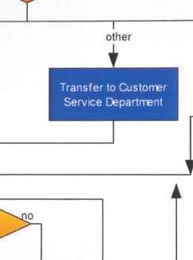
Document the
Preliminary Process Map
Complete “As Is” Process
Create a process map to arrange the process steps in time sequence
Document current process and identify customer/supplier relationships
Document the current way things are actually done, not the ideal, in order to identify opportunities
Keep a record of problems, ideas or suggestions for change

Slide 43
Exercise: Review and Draw Preliminary Process Map
Complete “As Is” Process
Objective
As a team, review and draw the consensus Process Map.
Instructions
Time to Complete
Team then compares each member’s process map and arrives at a “consensus” process map.
Instructor to provide
Deliverable
The consensus process map.
Notes:
Use post-it notes and chartpaper.

Slide 44
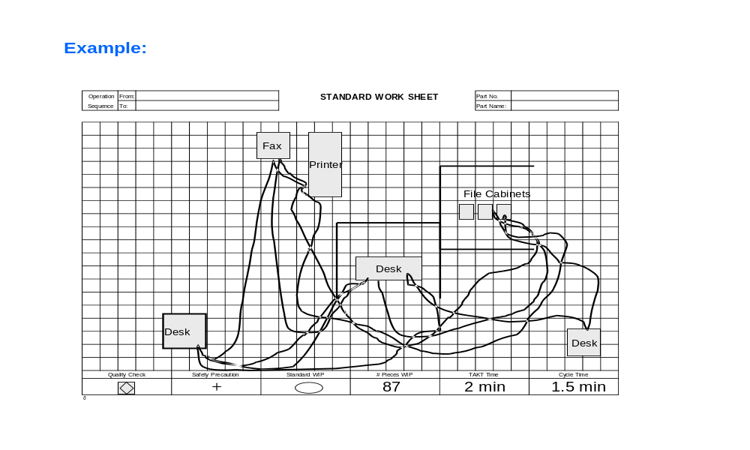
Draw Spaghetti Diagram for the As Is Process
Complete “As Is” Process
Draw a visual depiction of the physical and/or electronic path of the process as it exists today
Notes:
NOTE: To distinguish physical path from electronic path a best practice has been to use solid lines (denote physical walking or transportation) and dotted lines (for electronic – ie: e-mail, fax, etc.)

Slide 45
Steps to Describe the As Is Process
Complete “As Is” Process
    Confirm the boundaries of the process
Perform Process Walk #1
Document the preliminary Process Map
Draw the consensus “As Is” Process Map

Slide 46
Exercise: Draw a Consensus “As Is” Process Map
Complete “As Is” Process
Objective
Draw a consensus “As Is” Process Map
Instructions
Time to Complete
Now—using all we have seen by doing Walk #1,
Walk #2, Process Walk Forms, Process Data
Summary, and Spaghetti Diagram—re-draw a consensus “As Is” Process Map and include a data block underneath each process step.
Instructor to provide
Deliverable
Conduct Leadership Review of completed “As Is” Process Map

Slide 47

Conduct Leadership Review of “As Is” Process Map
Complete “As Is” Process
This is an opportunity to:
Confirm that we are still “in scope”
Confirm that we have no errors of omission or commission
Give leadership the advantage of an early “peek” so they can begin to think about what resources we may be likely to ask for (including lead time to overcome barriers to our objectives)

Slide 48
Identify and Define the
Barriers Within the “As Is” Process
Complete “As Is” Process
Identify &
Define Barriers
Identify
Potential
Solutions
Complete
“Should Be” Process
Define and
Implement Solution
Objectives:
Review types of waste
Differentiate between barriers and solutions
Identify Barriers to our goals that was observed in the “As Is” Process
Describe each Barrier and gain consensus as a team of the barriers
Prioritize Barriers by impact and time to implement
Notes:
DO: Review section objectives on slide.

Slide 49
Eight Wastes
Identify & Define Barriers
Wastes | Example
Defects
2. Over Production
3. Waiting
4. Non-Utilized Talent
5. Transportation
6. Inventory
7. Motion
8. Extra Processing
Notes:
DO: Ask the class to provide examples of the 8 wastes. Capture their answers on a chartpaper. The participants can write the answers in their workbooks.
POTENTIAL ANSWERS:
Transportation: Ops: Parts that are hand-carried or moved by conveyor, hand truck, tow motor, truck, ship, plane; Non-ops: Functional hand-offs (including electronic), document movement (physical or electronic)
Inventory: Ops: Accumulation of raw materials, WIP and finished goods stored in warehouses, or staging areas; Non-ops: Transactions/documents waiting in queue (e.g. incomplete customer order, unreleased engineering drawing)
Motion: Ops: Operators reaching for parts, bending, lifting, excessive movement within cell; Non-ops: Reaching, bending, unnecessary steps within office or work area
Waiting: Ops: Parts waiting to be processed by a machine or work cell; Non-ops: Time waiting to receive a quote from a supplier, turnaround time to get an approval
Overprocessing: Ops: Machining to overly tight tolerances, washing parts longer than required, excessive polishing; Non-ops: Excessive information, unnecessary reports, unnecessary approvals, excessive specifications
Overproduction: Ops: Producing more pieces than required, large batches, keeping machines “busy”; Non-ops: Working ahead of schedule, building up large transaction queues, keeping people “busy”
Defects: Ops: Rejected parts that do not meet specifications, parts damaged during processing or transportation; Non-ops: Customer orders with incomplete information, rejected drawings and documents, revisions/iterations
Behavioral Waste: Ops: Insufficient time devoted to continuous improvement, limited knowledge sharing; Non-ops: Insufficient time devoted to continuous improvement, limited knowledge sharing

Slide 50
Eight Wastes
Identify & Define Barriers
Wastes | Example
Defects | Incomplete information
2. Over Production | Unnecessary information
3. Waiting | Delays and queues
4. Non-Utilized Talent | Time not given for improvement
5. Transportation | Handoffs of information
6. Inventory | A task waiting to be started (WIP)
7. Motion | Walking, routing information
8. Extra Processing | Variation of process, unnecessary steps
Notes:
DO: Ask the class to provide examples of the 8 wastes. Capture their answers on a chartpaper. The participants can write the answers in their workbooks.
POTENTIAL ANSWERS:
Transportation: Ops: Parts that are hand-carried or moved by conveyor, hand truck, tow motor, truck, ship, plane; Non-ops: Functional hand-offs (including electronic), document movement (physical or electronic)
Inventory: Ops: Accumulation of raw materials, WIP and finished goods stored in warehouses, or staging areas; Non-ops: Transactions/documents waiting in queue (e.g. incomplete customer order, unreleased engineering drawing)
Motion: Ops: Operators reaching for parts, bending, lifting, excessive movement within cell; Non-ops: Reaching, bending, unnecessary steps within office or work area
Waiting: Ops: Parts waiting to be processed by a machine or work cell; Non-ops: Time waiting to receive a quote from a supplier, turnaround time to get an approval
Overprocessing: Ops: Machining to overly tight tolerances, washing parts longer than required, excessive polishing; Non-ops: Excessive information, unnecessary reports, unnecessary approvals, excessive specifications
Overproduction: Ops: Producing more pieces than required, large batches, keeping machines “busy”; Non-ops: Working ahead of schedule, building up large transaction queues, keeping people “busy”
Defects: Ops: Rejected parts that do not meet specifications, parts damaged during processing or transportation; Non-ops: Customer orders with incomplete information, rejected drawings and documents, revisions/iterations
Behavioral Waste: Ops: Insufficient time devoted to continuous improvement, limited knowledge sharing; Non-ops: Insufficient time devoted to continuous improvement, limited knowledge sharing

Slide 51
Causes of Transactional Waste
Identify & Define Barriers
Functional Organization
Information Technology gaps
Excessive controls
Outdated process design
No back-up/cross-training
Unbalanced workload
System batching
Changing Priorities
Responsibilities not defined
Poor visual control
Disorganized workplace
Lack of training
Obsolete forms
No SOPs
Notes:
SAY: “Let’s take a look at some causes of transactional waste.”
ASK: Do any of these causes exist in your current daily activities? (ask for an example, then ask “What wastes do you see as a result from that?”)

Slide 52
Barriers vs. Solutions
Identify & Define Barriers
A barrier states the obstacle to the goal
A solution states how to overcome the obstacle in order to
achieve the goal
It is tempting to work on solutions before we define barriers
Important to keep in mind:
  A common pitfall at this point in the event is to jump to solutions
  Steer clear of this… it will lead to lots of talking and no acting
  At this point we are only identifying and defining barriers
Notes:
SAY: “Just as it is tempting to start working on the “Should be” when we are still trying to define the “As Is”—it is tempting to work on solutions before we define barriers.”
SAY: “When you think of the wastes that are barriers… think of what is causing that waste to happen… that is the true barrier.”

Slide 53
Barrier Definition and Selection
Identify & Define Barriers
1
2
3
Identify Barriers
Define Barriers
Select and Prioritize
Use the brainstorming process to provide a brief name for each barrier
Limit name to 3 words max
No judgments made at this point
Move quickly and list as many as possible
Go back and write a brief description for each barrier
Limit to 3 sentences max
Avoid jumping to solutions
Review each barrier and gain team consensus on which to keep and which to discard
Use the matrix on the following slide to prioritize remaining barriers

Slide 54
Prioritize Remaining Barriers by Impact and Time to Implement
Identify & Define Barriers
H
Attack first!
Do it !
Attack next
(as decided by team)
MH
Do it !
Level of Impact
Consider Alternatives
M
Attack next
(as decided by team)
Don’t attack
ML
Defer unless a
1-person team
Consider
Alternatives
L
ML
M
MH
H
Level of Effort to Implement
(Cost, Time, Resources)
Notes:
NOTE: This is also called a “PICK” Diagram: Possible Implement Challenge Kill.

Slide 55
Brainstorming Barriers
Identify & Define Barriers
Goal: Incoming faxes arrive completely and to the correct person within 1 hour of receipt
Examples of Barriers:
  Electricity outage
  No fax paper
  No cover sheet
  No ownership
  No specific location
  Faxes mixed with copies

Slide 56
Example
Identify & Define Barriers
Barriers | Barrier Descriptions | Selected Barriers
Electricity outage | When there is a power outage, there is no way to tell if an incoming fax was missed.
No fax paper | When the fax machine may run out of paper during the middle of receiving an incoming fax. | X
No cover sheet | There are times no cover sheets arrive with the faxes so we cannot tell if it is a fax or a print out, who it belongs to, and how many pages were sent.
No ownership | There is no one responsible for the correct distribution of faxes. People just bring faxes to each other when they are at the copy machine if they happen to see one there. | X
No specific location | There is no defined place to deliver the fax. Some people leave on chairs, on desks, or on in-boxes. | X
Faxes mixed with copies | The fax machine, copy machine and printer are all-in-one. If someone prints a document while a fax is being received it can bury the fax within the document. | X

Slide 57
Prioritize Remaining Barriers by Impact and Time to Implement
Identify & Define Barriers
H
No
ownership
Do it !
No fax
paper
No
specific
location
MH
Do it !
Level of Impact
Consider Alternatives
M
Faxes
mixed
with
copies
ML
Defer unless a 1-person team
Consider
Alternatives
L
ML
M
MH
H
Level of Effort to Implement
(Cost, Time, Resources)

Slide 58
Exercise: Barriers
Identify & Define Barriers
Objective
Complete the process to identify, define, select and prioritize the observed barriers.
Instructions
Time to Complete
Using the steps identified in the previous slides:
Brainstorm all observed barriers (3 word)
Define each barrier (3 sentence)
Determine which barriers to select as a team
by consensus
Use the matrix to prioritize the selected
barriers
Instructor to provide
Deliverable
Barriers selected and prioritized.

Slide 59
Conduct Leadership Review of Barriers
Identify & Define Barriers
This is an opportunity to:
Confirm that we are still “in scope”
Confirm that we have no errors of omission or commission
This is one way to match our barriers list with Leadership’s view of resources and acceptable time-lines for improving the Process we are looking to improve

Slide 60
Identify Potential Solutions to the Barriers
Complete “As Is” Process
Identify &
Define Barriers
Identify
Potential
Solutions
Complete
“Should Be” Process
Define and
Implement Solution
Objectives:
Review improvement tools typically used to identify solutions
Identify solutions to the selected barriers
Gain consensus on solutions as a team
Prioritize solutions by impact and time to implement
Notes:
DO: Review section objectives on slide.

Slide 61
Using Lean Tools to Arrive at Solutions
Identify Potential Solutions
Use the “Lean Toolbox” as needed to determine solutions
to the barriers
See Appendix A thru D for an overview of various lean tools
As needed, your event facilitator will guide the team through the use of any of these lean tools

Slide 62
Brainstorming Solutions
Identify Potential Solutions
1
2
3
Identify Solutions
Define Solutions
Select and Prioritize
Use the brainstorming process to provide a brief name for a solution to each barrier that made the consensus list
Limit 3 words max
No judgments made at this point
Move quickly and list as many as possible
Go back and write a brief sentence description for each solution
Limit 3 sentences max
Review each solution and gain team consensus on which to keep and which to discard
Use the 2 x 2 matrix to force rank potential solutions if necessary
Notes:
DO: Review the Japanese origins and definition of the term, poka-yoke.
SAY: “Poka Yoke is also called mistake-proofing, error-proofing, and baka-yoke (fool proofing)”
SAY: “Poka-Yoke refers to methods that help associates avoid mistakes in their work caused by choosing the wrong item, leaving out an item, or any other form of doing something incorrectly.”
SAY: “Poka-yoke is the highest level of jidoka. Jidoka is another Japanese term that refers to providing systems, programs, and associates the ability to detect when an abnormal condition has occurred and immediately stop work. This allows associates to build quality into each process of their work.”
ASK: “What are other error proofing examples?”
Car safety belt warning light or buzzer
Clothes iron that shuts itself off if left on inadvertently
Garage door opener with safety reversing switch
Lawn mower with safety release handle for shutting off mower
A car that cannot be started in gear
Microwave ovens that will not start with the door open

Slide 63
Example
Identify Potential Solutions
Barriers | Barrier Descriptions | Solutions | Solution Description
No fax paper | When the fax machine may run out of paper during the middle of receiving an incoming fax. | Signal to PC Assign ownership No more faxes Route to e-mail | Have a pop up box appear at a person’s pc to inform them when the machine is out of paper Designate a person who is responsible for faxes and ensuring paper is loaded Eliminate faxes altogether – use scanning and e-mail attachments Purchase and download software that will route all incoming faxes as pdfs to people’s e-mail accounts

Slide 64
Prioritize Solutions by
Impact and Time to Implement
Identify Potential Solutions
H
Assign
ownership
Do it !
MH
Do it !
Route to e-mail
Level of Impact
Consider Alternatives
M
Signal to PC
No
more faxes
ML
Defer unless a
1-person team
Consider
Alternatives
L
ML
M
MH
H
Level of Effort to Implement
(Cost, Time, Resources)

Slide 65
Exercise: Solutions
Identify Potential Solutions
Objective
Follow the brainstorming process to identify, define and select the solutions for each barrier from the previous exercise.
Instructions
Time to Complete
Use improvement tools to identify, define, select and prioritize solutions for each barrier.
Instructor to provide
Deliverable
Solutions identified

Slide 66
Conduct Leadership Review of Solutions
Identify Potential Solutions
This is an opportunity to:
Confirm that we are still “in scope”
Confirm that we have no errors of omission or commission
Give leadership the advantage of an early “peek” so they can begin to think about what resources we may be likely to ask for (including lead time to overcome barriers to our objectives)

Slide 67
Complete Description of the “Should Be” Process
Complete “As Is” Process
Identify &
Define Barriers
Identify
Potential
Solutions
Complete
“Should Be” Process
Define and
Implement Solution
Objectives:
Complete the “Should Be” Process Flow Map
Complete the “Should Be” Process Documentation
Notes:
DO: Review section objectives on slide.

Slide 68
Creating the Should Be Process
Complete ”Should Be” Process
Begin by asking from the
customer’s perspective
“What would the ideal
process look like?”
What is driving the non-value added?
Lack of Visual Systems?
Lack of Standard Work?
Lack of Flow?
Excessive handoffs?
Process Complexity?
  What steps can be eliminated or redesigned?
Create high level process
flow from this
Where is the non-value
added?
What is driving
the non-value added?
Notes:
Lack of flow = batch processing and bottlenecks.

Slide 69
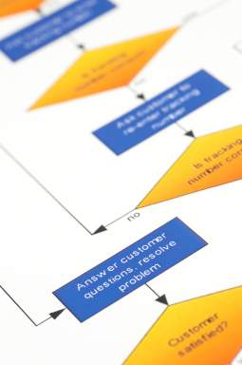
Draw the Initial Consensus Should Be Process Map
Complete ”Should Be” Process
Discuss amongst team to reach consensus
Draw initial consensus Should Be Process Map

Slide 70
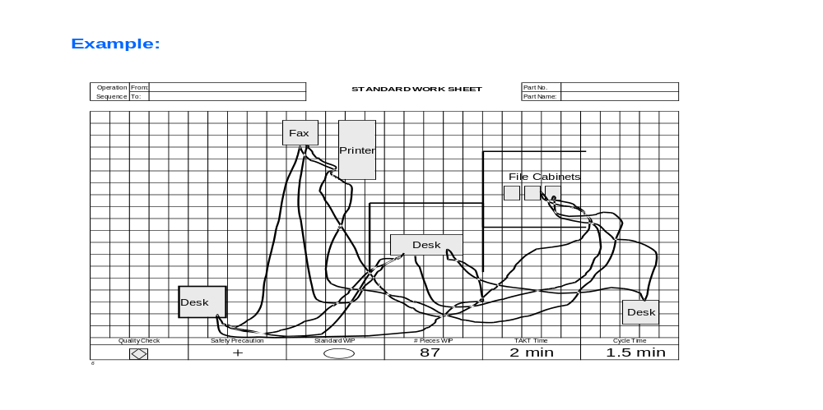
Draw Spaghetti Diagram for Should Be Process
Complete ”Should Be” Process
Same methodology as the Spaghetti Diagram for the As Is Process

Slide 71
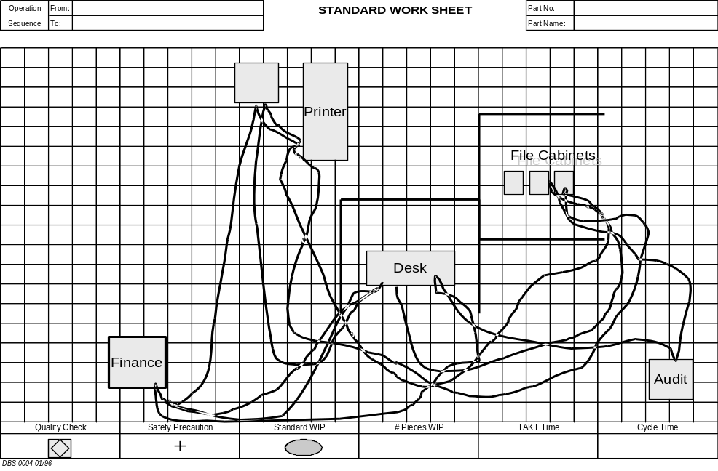
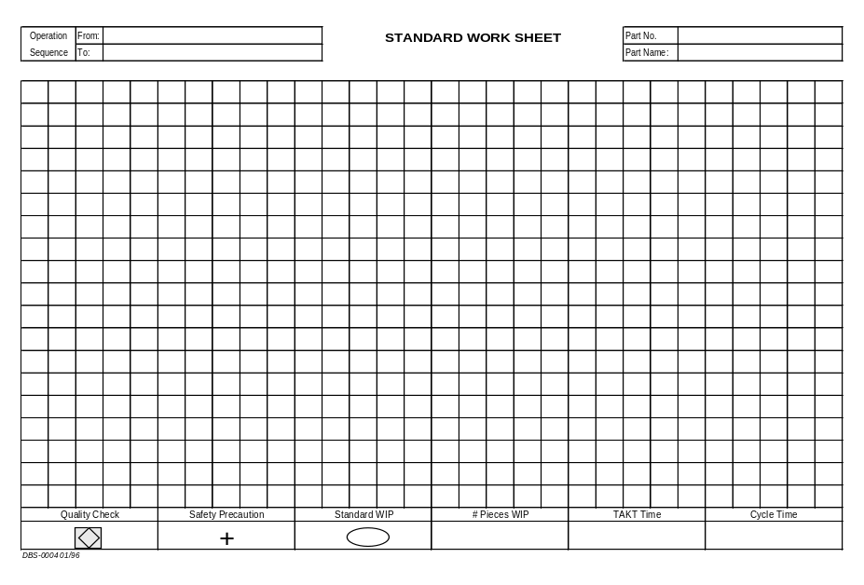
Typical Considerations for the “Should Be” Process
Complete ”Should Be” Process
Do we need to change our layout to co-locate process steps?
“As Is” Layout
“Should Be” Layout
Instructions:
1. Task A
2. Task B
3. Task C
Processing
Area
Printer
& Fax
Desk
File
Cabinets
Do we need create standard work?
71

Slide 72
Draw the Revised Consensus
Should Be Process Map
Complete ”Should Be” Process
Reflecting upon latest Process Data Summary and latest Spaghetti Diagram
  Have discussion amongst team to reach consensus on Should Be Process
  Draw the revised consensus Should Be Process Map

Slide 73
Exercise: Complete
Should Be Process Documentation
Complete ”Should Be” Process
Objective
Define the “Should Be” Process.
Instructions
Time to Complete
For each process block, fill in Component Tasks of the Process Walk Form with data-based approved Barriers and Solutions.
Complete the Process Data Summary Sheet
and Spaghetti Chart for the “Should Be Process.”
Make any updates to the “Should Be Process Map” as needed.
Instructor to provide
Deliverable
Should Be Process Documentation complete

Slide 74
Conduct Leadership Review of Should Be Process
Complete ”Should Be” Process
This is an opportunity to:
Review latest consensus Should Be Process Map with Leadership
Gain approval to proceed with final detailing and implementation of Solutions to achieve Should Be Process

Slide 75
Define and Implement Solutions
Complete “As Is” Process
Identify &
Define Barriers
Identify
Potential
Solutions
Complete
“Should Be” Process
Define and
Implement Solution
Objectives:
Determine resources needed for each solution
Assign organizational responsibility for each solution
Identify components of Kaizen Newspaper
Identify purpose of Future Plans Sheet
Complete procedure schedule
Implement improvements
Conduct report-out presentation to leadership
Notes:
DO: Review section objectives on slide.

Slide 76
Label Each Solution
Define and Implement Solutions
 | One person team This kind of solution only takes one person and requires no formal event Just do it!
 | Multiple person team This kind of solution only takes 2 or 3 people from the same function and does not require a formal event Just do it!
 | Cross-functional team This takes 2 or more people who are from more than one function Takes more time and coordination than MPT events but does not require a full tool event with a Sensei
 | Full Kaizen Event, cross-functional team, Sensei required
OPT
MPT
CFT
FKE
Notes:
Label each solution next to the kaizen description and or on the kaizen newspaper and future plans

Slide 77
Assign Organizational Responsibility for Each Solution
Define and Implement Solutions
Each name and date for each item must be agreed to by the individual named; it is assumed they gained appropriate higher level approval to accept responsibility

Slide 78
Determine Tasks to be Accomplished
Define and Implement Solutions
Roles and Responsibility Matrix
New Documents, Checklists
Training Plan
New Reports
Metrics for New Process
Complete Standard Work Sheets
Other Deliverables from Team Charter
  Separate by time to complete:
    This Week
    Within 4 weeks
    Within 5 weeks -6 months

Slide 79
Define Purpose and Components of Kaizen Newspaper
Define and Implement Solutions
Purpose of the Kaizen Newspaper is to track progress on implementing solutions after the event has concluded (4 week time horizon)
The top of the form must bear the name of the event; date of the event, Team Leaders Name.
  Example: TPI – Order Configuration - Order Entry Value Stream – 01-26-07 – Tom Swift
An item must have a brief description, owner’s name the date
  Must be accepted by the person whose name appears for that item
Newspapers with open items should be reviewed on a fixed day each week
  Attendees should include Leadership, VS Managers, Team Leaders, Process Owners, and Improvement Item Owners
Notes:
The purpose of the Kaizen Newspaper is to track progress on solutions defined during the event, not implemented during the event, but agreed to be implemented within 4 weeks from the Friday ending the event
The top of the form must bear the name of the event; date of the event, Team Leaders Name. Example – TPI – Order Configuration - Order Entry Value Stream – 01-26-07 – Tom Swift
An item must have a brief description (the “3 sentence” description is fine), must have a person’s name next to it and a date—all of which must be accepted by the person whose name appears for that item
Newspapers with open items should be reviewed on a regular fixed day each week; attendees to that regular meeting should include Leadership, VS Managers, and the Team Leaders

Slide 80
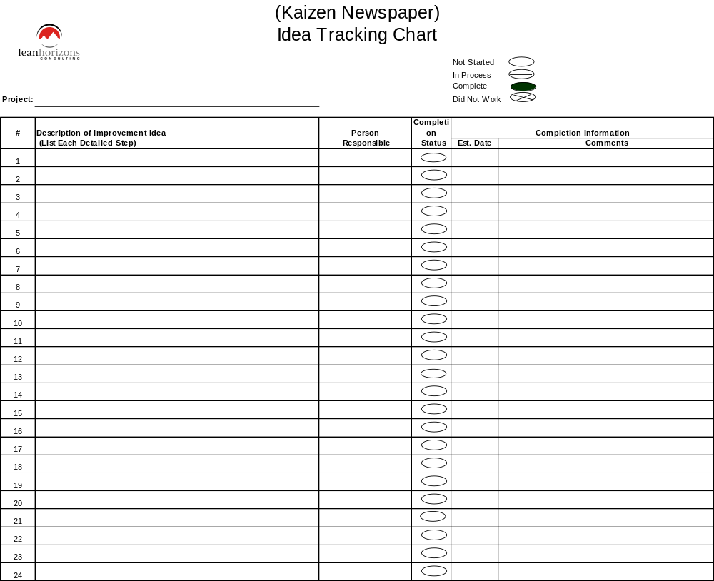
Kaizen Newspaper Form
Define and Implement Solutions
Notes:
If date slips on action plan, enter new date but do not erase the original date nor any of the subsequent dates.
Resource labels (OPT, MPT, CFT, and FKE) are also labeled/transferred to this document.

Slide 81
Future Plans
Define and Implement Solutions
Purpose of the Future Plans Sheet is to track progress on solutions defined during the event to be completed within 5 weeks - 6 months from the Friday ending the event
An item must have a brief description (the “3 sentence”
description is fine)
An item must have an individual’s name, month of completion, and (OPT, MPT, etc.) resource label
As an item moves into the 4 week horizon it should be added to the Kaizen Newspaper and be handled per the description given for Kaizen Newspapers

Slide 82
Complete Procedure Schedule
Define and Implement Solutions
For procedures (SOPs) that are to be part of the “solutions” we should maintain a schedule showing name of author, date to be completely written, name of implementation leader, date to begin implementation, date to complete implementation

Slide 83
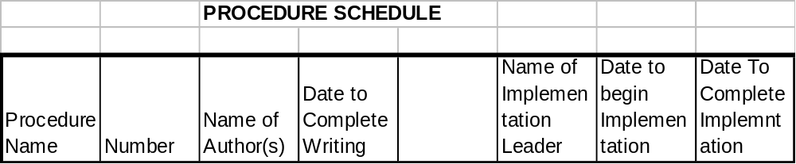
Procedure Schedule Example
Define and Implement Solutions

Slide 84
Develop and Complete Compelling Report Out Presentation
Define and Implement Solutions
(Target 15 Minutes for Report Out)
PowerPoint of less than 1MB size
Team Photo (with names)
Goals, Objectives and Deliverables
“As-Is” and “Should-Be” Process Maps
Process Walk Form example for one process block
Process Summary sheets .xls for one Swim Lane if appropriate (ask Consultant)
As time permits – more photos, spaghetti charts, but always show before and after on same slide
Accomplishments
Kaizen Results Form
Kaizen Newspaper Form
Future Plans
Lessons Learned

Slide 85
Exercise: Implement Solutions and Schedule
Define and Implement Solutions
Objective
Implement solutions.
Instructions
Time to Complete
Use the remainder of the event to implement the “OPT”, “MPT”, and “CFT” solutions that can be completed this week.
Complete the Kaizen Newspaper and Future Plans for any items that do not or may not be
accomplished during the event.
Instructor to provide
Deliverable
Improvements implemented and
kaizen newspaper and future plans completed

Slide 86
Appendix A
Problem Solving Tools
Notes:
NOTE: The following appendices are intended to provide a definition of the various improvement tools. For a deeper dive into any of these tools, refer to the specific training module for that tool.

Slide 87
9 Steps to Problem Solving
1. DESCRIBE PROBLEM
(WHO, WHAT, WHERE, WHEN)
5. IMPLEMENT TEMPORARY COUNTERMEASURES
(IF NECESSARY)
7. PROPOSE & IMPLEMENT COUNTERMEASURES
(HOW TO SOLVE THE PROBLEM)
(Collect Data)
Pareto Chart
6. DETERMINE CAUSE(S)
(WHY PROBLEM IS OCCURRING)
8. MONITOR COUNTERMEASURE EFFECTIVENESS
2. VISUALLY QUANTIFY PROBLEM & OBJECTIVE
2
Manpower
Methods
P.C.
Board
Yield
NO
Too
OBJECTIVE MET?
CUSTOMER SATISFIED?
3. DOCUMENT CURRENT PROCESS
Low
Wrong
Materials
Machinery
Why?-->
Why?-->
Why?-->
Why?-->
Why?
YES
4. IDENTIFY CUSTOMER/SUPPLIER RELATIONSHIPS
9. ESTABLISH STANDARD PROCEDURE
Pareto Chart
Notes:
DO: Review the nine steps to solving a problem and state that we will go into much more depth on each step.

Slide 88
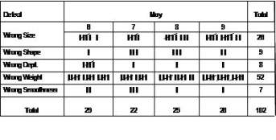
Problem Solving Tools
Check Sheet
Histogram
Tool for collecting and organizing facts and data
When you need to gather data based on sample observations in order to begin to detect patterns. This is the logical point to start in most problem solving cycles
Data collection and presentation tool for frequency of occurrence
When you need to discover and distribute data by bar graphing the number of units in each category
88
Notes:
DO: Review the tools, ask the group if they have had any experience with the tools. Call on participants to share how they used these tools in the past.

Slide 89
Problem Solving Tools
Pareto Diagram
Scatter Diagram
Separates vital few from trivial many; organizes data from highest value to lowest
When you need to display the relative importance of all conditions in order to: choose the starting point for problem solving, monitor success, and identify the basic cause of a problem
X-y graph to determine the relationship between variables
When you need to display what happens to one variable when another variable changes in order to test a theory that the two variables are related
Height
Weight
89
Notes:
DO: Review the tools, ask the group if they have had any experience with the tools. Call on participants to share how they used these tools in the past.

Slide 90
Problem Solving Tools
Run Chart
Control Chart
Method of graphing trends
When you need to do the simplest possible display of trends within observation points over a specified time period
Statistically determines upper and lower control limits based on the process average
When you need to determine whether a process is in statistical control
UCL
Measurement
Measurement
LCL
Time
Time
90
Notes:
SAY: “Use Control Charting when you need to discover how much variability in a process is due to random variation and how much is due to unique events/individual actions in order to determine whether a process is in statistical control.”
DO: Review the tools, ask the group if they have had any experience with the tools. Call on participants to share how they used these tools in the past.

Slide 91
Problem Solving Tools
5 Whys
Method of breaking down the problem to its root cause
When you need to implement corrective action and want to be sure your actions will address root cause, not symptoms
Why?
Why?
Why?
Why?
Why?
91
Notes:
DO: Review the tools, ask the group if they have had any experience with the tools. Call on participants to share how they used these tools in the past.

Slide 92
CEDAC
Defined
Benefits
When to Use
Cause and Effect Diagram with the Addition of Cards
A tool which covers every step in the Customer Focused Problem Solving Process
CEDAC involves everyone in the Problem Solving Process, even those not directly working on the problem because it is visually displayed in the workplace
Extremely useful for multi-shift operations
When you need to identify, explore and display the possible causes of, and potential solutions to, a specific problem or condition
When team-based involvement is essential to the successful root cause solution to a specific problem
CEDAC involves everyone in the Problem Solving Process
92
Notes:
SAY : “CEDAC is a tool which covers every step in the Customer Focused Problem Solving Process.
It involves everyone in the Problem Solving Process, even those not directly working on the problem because it is visually displayed in the workplace, thus providing easy access. Because of this, it is also extremely useful for multi-shift operations.”
SAY: “When should you use CEDAC?
When you need to identify, explore and display the possible causes of, and potential solutions to, a specific problem or condition.
When team-based involvement is essential to the successful root cause solution to a specific problem.”

Slide 93
Problem Solving Tools
Flow Charts
Cause and Effect Diagram
Pictorial representation showing all steps of a process
When you need to identify the actual and ideal path that any product or service follows in order to identify problems
Method for organizing ideas (Fishbone diagram)
When you need to identify, explore and display the possible causes of a specific problem or condition
Manpower
Methods
P.C.
Board
Yield
Too
Low
Wrong
Materials
Machinery
93
Notes:
DO: Review the tools, ask the group if they have had any experience with the tools. Call on participants to share how they used these tools in the past.

Slide 94
Appendix B
5S and Visual Management
94

Slide 95
Goal of 5S
Benefits of 5S Culture
The goal of 5S is to create workplace organization, improve productivity, enable visual management, and lay the foundation for all other lean tools.
Safety
  Reduce the number of lost time accidents, worker’s compensation claims and OSHA recordables
Quality
  Eliminate the possibility of using previously rejected parts or the wrong tools; eliminate contamination and assure compliance to standard procedures
Productivity
  Eliminate wasted time looking for tools; reduce cycle time, reduce equipment downtime through regular cleaning and inspection
95

Slide 96
5S – English Translations
1S – Sort | Define what is necessary and unnecessary
2S – Straighten | A place for everything and everything in its place
3S – Scrub | Thoroughly clean the area and identify the sources of uncleanliness
4S – Standardize | Execute process to maintain/improve the standards of the first 3 S’s
5S - Sustain | A sustained, disciplined 5S culture in the workplace
96

Slide 97
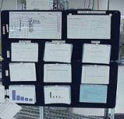
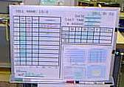

Visual Management
Visual Management allows us to separate the Normal from the Abnormal at a glance
This enables any level of the organization to very quickly find the focus for their efforts
If you don’t have visual management…how do you know what to work on?
97

Slide 98
Appendix C
Poka-yoke
98

Slide 99
Poka-Yoke: Error-Proofing
Poka-Yoke
Jidoka
Examples
A Japanese term meaning “mistake-proof”
  Inadvertent errors (Poka)
  To avoid (yokeru)
A method of designing processes that will prevent errors
Also referred to as “autonomation,” means a method of transferring human intelligence to the process
The process detects abnormalities and stops when detected
Motion detect light switches room enter and exit
Car stops when object in path
Auto shut-off irons
Automatic sinks in public restrooms
Low clearance barriers in parking garage
99
Notes:
DO: Review the Japanese origins and definition of the term, poka-yoke.
SAY: “Poka Yoke is also called mistake-proofing, or error-proofing.”
SAY: “Poka-Yoke refers to methods that help associates avoid mistakes in their work caused by choosing the wrong item, leaving out an item, or any other form of doing something incorrectly.”
SAY: “Poka-yoke is the highest level of jidoka. Jidoka is another Japanese term that refers to providing systems, programs, and associates the ability to detect when an abnormal condition has occurred and immediately stop work. This allows associates to build quality into each process of their work.”
ASK: “What are other error proofing examples?”
Car safety belt warning light or buzzer
Clothes iron that shuts itself off if left on inadvertently
Garage door opener with safety reversing switch
Lawn mower with safety release handle for shutting off mower
A car that cannot be started in gear
Microwave ovens that will not start with the door open

Slide 100
Poka-Yoke Philosophy
Promotes defect prevention vs. defect detection
Recognizes that people forget and make errors, and machines and processes fail and make errors
Respects the intelligence of workers by taking the judgment out of repetitive tasks or actions where errors are likely to occur
Utilizes people working in the process to “mistake-proof” the process because they own it
100
Notes:
DO: Review key points on the slide. As if anyone has experience implementing poka-yokes in the workplace and if yes, to share.

Slide 101
Appendix D
Standard Work
101

Slide 102
Standard Work—Defined
A tool that defines the interaction of people and their environment when processing a product or service
Details the motion of the operator and the work sequence of the operator
Provides a routine for consistency of an operation
Details the best process we currently know and understand
Provides a basis for improvement by defining the normal and highlighting the abnormal
There can be no improvement without a standard!
102

Slide 103
Transactional Standard Work you already know
SOP’s
Forms, Tables, Checklists
Pictures
Flow charts
Worksheets
103

Slide 104
Standard Operating Procedures (SOPs)
Pictures
Diagrams
Signs
Written Text
Electronic Instructions
104

Slide 105
Cellularization
Construct U-Shaped Cells that link processes and locate
teams together
Equipment and layout should permit easy material and
information flow
Make equipment easy to disconnect and relocate
Utilize the open room concept for better visual management and to improve associate communication
Process should be pulled to takt time - do not allow room or capability for batching
Implement single piece flow and avoid excessive WIP
105

Slide 106
How Many People Do We Need?
Staffing is approximated using
# of People = Sum of Individual Process Cycle Times
Takt Time
106

Slide 107
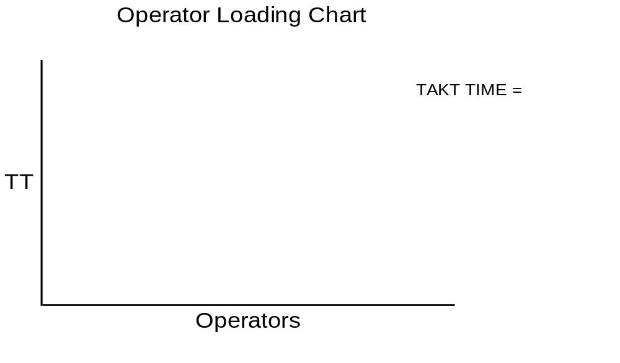
Operator Loading Chart
107

Slide 108
Operator/Process Loading Chart
Visual picture of time allocated to each team member
Documents how many people are on the team for a given process
Plotted against TAKT Time
Post at mouth of cell
108

Slide 109
Standardized Work
TAKT Time
A
B
C
D
E
Natural
TAKT Time
A
B
C
D
E
Traditional
TAKT Time
"Least Operator"
A
B
C
D
E
109

Slide 110
Least Operator Concept
Cell should be front loaded
All waiting time is allocated to the “least” processor
All other team members should be loaded fully to TAKT time
Makes the waiting waste visible
Exposes opportunity for improvement
110

Slide 111
Other Modules In This Series:
5S
Standard Work
Total Productive Maintenance (TPM)
Administrative Lean
Cell Design/ Production Preparation Process (3P)
Kaizen
Kanban
Problem Solving
Poka Yoke Quality Systems
Transaction Process Improvement (TPI)
Cause & Effect Diagram with the Additions of Cards (CEDAC)
Single Minute Exchange of Dies (SMED)
Value Stream Mapping (VSMi®)
Visual Management
Managing Daily Process Excellence
For More Information Please Contact:
Mark DeLuzio, President and CEO
+1.860.234.0915
mark.deluzio@leanhorizons.com
Strategically Creating Value Through the Elimination of Waste
111

